Slide 1
I will be able to use the periodic table to describe the structure of the atom
TRACK WITH ME
READ WITH ME
I can determine the number of protons, neutrons and electrons in an element
I can draw the structure of an atom (including number of electrons)

Slide 2
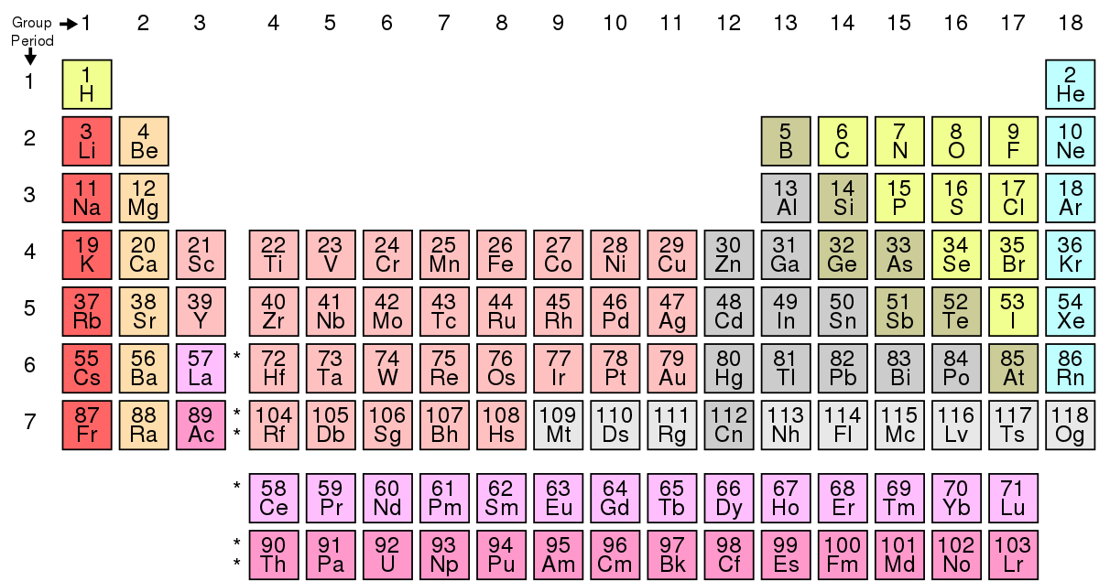
I will be able to use the periodic table to describe the structure of the atom

Slide 3
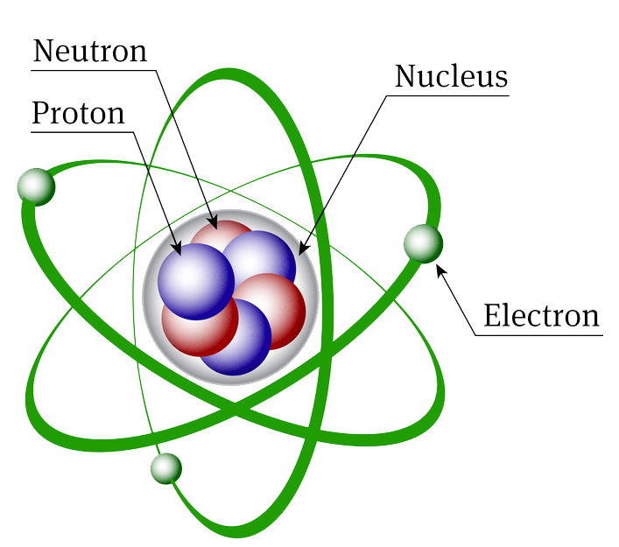
I will be able to use the periodic table to describe the structure of the atom
An atom is made up of protons, neutrons and electrons

Slide 4
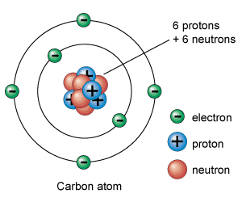
I will be able to use the periodic table to describe the structure of the atom
A proton has a positive charge and is found in the nucleus of an atom.
A neutron has no charge and is found in the nucleus of an atom
A electron has a negative charge and is found in rings (called shells) around the nucleus.

Slide 5
I will be able to use the periodic table to describe the structure of the atom
MAKE THE CONNECTION
Each circle represents an extra electron
As you move across the periodic table what do you notice?

Slide 6
I will be able to use the periodic table to describe the structure of the atom
The atomic number at the top of the periodic table tells you the number of protons in an atom. This also tells you the number of electrons in an element.
The Mass number at the bottom of the element tells you the number of protons + neutrons.
To work out neutrons you need to subtract the atomic number from the mass number

Slide 7
I will be able to use the periodic table to describe the structure of the atom
Can you see a pattern?
The number of protons increases as you move across the periodic table
That is how elements are defined between one another.

Slide 8
I will be able to use the periodic table to describe the structure of the atom
Can you fill in this table?
Upload a photo of this in your book to the submission link on connect

Slide 9
I will be able to use the periodic table to describe the structure of the atom
How are electrons arranged?
All of the protons and the neutrons
The 3rd ring can hold up to 18 e⁻
The 1st ring can hold up to 2 e⁻
The 4th ring and any after can hold up to 32 e⁻
The 2nd ring can hold up to 8 e⁻

Slide 10
MAKE THE CONNECTION
Extension: Elements that exceed 20 do not fit with the rule and instead have 18 electrons in the 3rd shell.
I will be able to use the periodic table to describe the structure of the atom
How are electrons arranged?
Electron configuration – is how the electrons are arranged in the atom
We have a rule – the “2,8,8,2 (works for the first 20 elements)
1st shell – holds 2 electrons
2nd shell – holds 8 electrons
3rd shell – holds 8 electrons
4th shell - ……2 electrons

Slide 11
I will be able to use the periodic table to describe the structure of the atom
Lets determine the structure of Carbon
Step 1: determine the amount of electrons
Step 2: Fill the first shell (maximum can hold is 2) Step 3: Fill the second shell (maximum can hold is 8)
Eg. Carbon = 6 electrons
- 2 electrons go in the first shell
- 4 electrons go in the second shell

Slide 12
I will be able to use the periodic table to describe the structure of the atom
Mass # = 12 atomic # = 6
p⁺ = 6 nº = 6 e⁻ = 6
Electron configuration = 2,4
6 p and 6 n live in the nucleus

Slide 13
I will be able to use the periodic table to describe the structure of the atom
MAKE THE CONNECTION
Please upload your work on connect!
Based on the 2,8,8,2 rule can you draw models to show the atomic structure of:
Helium
Boron
Flourine
Make sure you include a key to show each type of particle.
Extension
If you feel comfortable, can you draw electrons in pairs(this helps when we start thinking about bonding)

Slide 14
I will be able to use the periodic table to describe the structure of the atom
TRACK WITH ME
READ WITH ME
I can determine the number of protons, neutrons and electrons in an element
I can draw the structure of an atom (including number of electrons)

